Slide 1
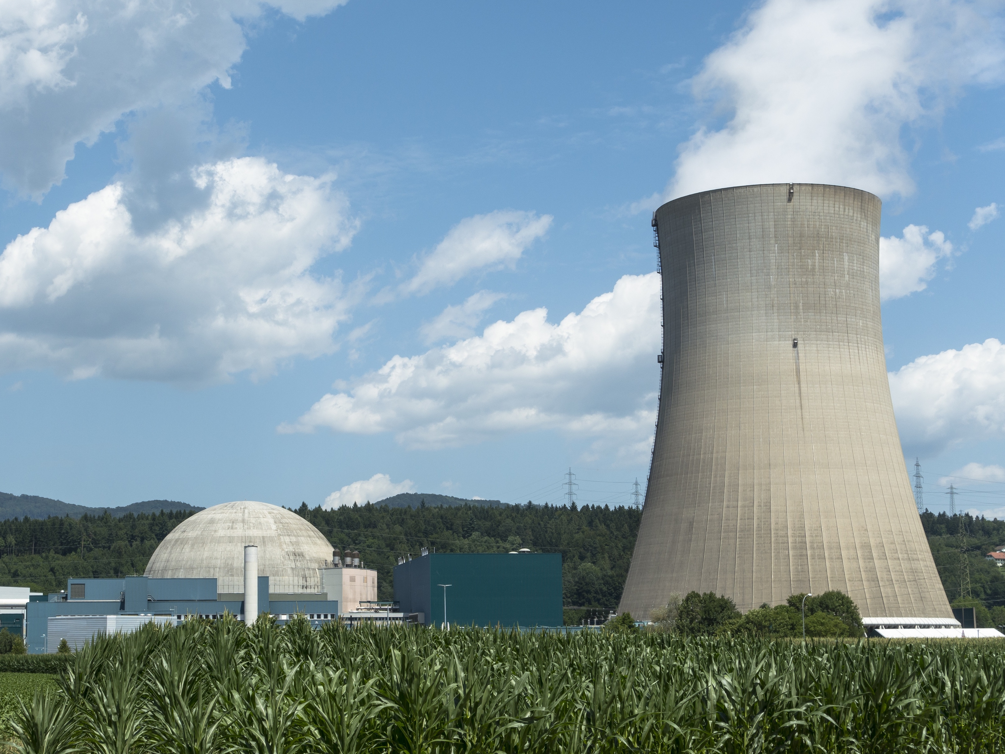
Nuclear Chemistry:
Types of Nuclear Radiation

Slide 2
Unstable Atoms
Unstable atoms emit excess energy from their nuclei to become more stable. The energy and particles released are called nuclear radiation.
+
+
Unstable Nucleus
Stable Nucleus
Particles
Energy
Radiation

Slide 3


Types of Radiation
Alpha Particles: Identical to a helium nuclei.
4
2
He
Beta Particles:
Electrons emitted as radiation.
0
-1
e
γ
γ
Gamma Rays:
Emitted as a wave, not a particle.
0 0

Slide 4
Alpha Particles
Largest of the nuclear radiation particles.
Because of the size, has the least penetrating power. Can be stopped by paper or skin.
Least dangerous form of radiation.
4
2
He

Slide 5
Beta Particles
Smaller particles. Can penetrate skin.
Can be stopped by metal or wood.
γ
Gamma Rays
No mass and high penetrating power.
Extremely dangerous. Can be stopped by thick layers of concrete.

Slide 6
Strength of Radiation
Alpha Radiation
Beta Radiation
Gamma Rays
Sheet of Paper
Sheet of Aluminum
Thick Concrete Wall

Slide 7
Alpha Decay
238
92
U
234
90
Th
4
2
+
He
Unstable Nucleus
Stable Nucleus
Alpha Particle

Slide 8
Beta Decay
14
6
C
14
7
C
+
0
-1
e
Unstable Nucleus
Stable Nucleus
Beta Particle

Slide 9
Gamma Decay
Tc
γ
99
43
Tc*
99 43
+
0
0
Unstable Nucleus
Stable Nucleus
Gamma Ray

Slide 10
Uses of Radiation
Cancer Treatment:
Radiation is used to destroy cancer cells.
Nuclear Medicine: Radioactive substances can be inserted into the body to view internal organs.
Food Irradiation: Radiation can be used to reduce or eliminate bacteria on food.

